Slide 1



Wikidata for academics
Large-scale, interdisciplinary, multilingual, open data
October 2020,CC BY 4.0

Slide 2




Outline
Why should you be interested in Wikidata?
A brief introduction to the largest open knowledgebase
Why you might draw data from it
Why you might deposit data into it
How to put data in
How read data from
Different ways to editing and create items
One at a time (direct manual editing)
Multiple at once (tool assisted batch editing)
Query information back out of Wikidata
SPARQL tool (and language)
A wide range of custom examples
Help, community and resources
The hidden world behind Wikidata

Slide 3

Wikipedia
z
Open access encyclopedia
300 language editions
Most-read source for most topics
Many pages read >100,000 times per year
Consulted by >95% of students
Consulted by >60% of clinicians
Consulted by >95% of researchers
Fox S, Jones S. Pew Internet. 2009 | Hughes B, Joshi I, Lemonde H, Wareham J. Int J Med Inform 2009 Oct;78(10):645-655 | Allahwala UK, Nadkarni A, Sebaratnam DF. Med Teach 2013 Apr;35(4):337 | Nutzung von Social-Media-Diensten in der Wissenschaft 2017 Goportis – Leibniz-Bibliotheksverbund

Slide 4
Wikidata
z
Structured data knowledgebase
Machine-readable
Multilingual
Inter-disciplinary
e.g. Research output metadata
e.g. Scholar & researcher data
e.g. Conceptual relationships

Slide 5
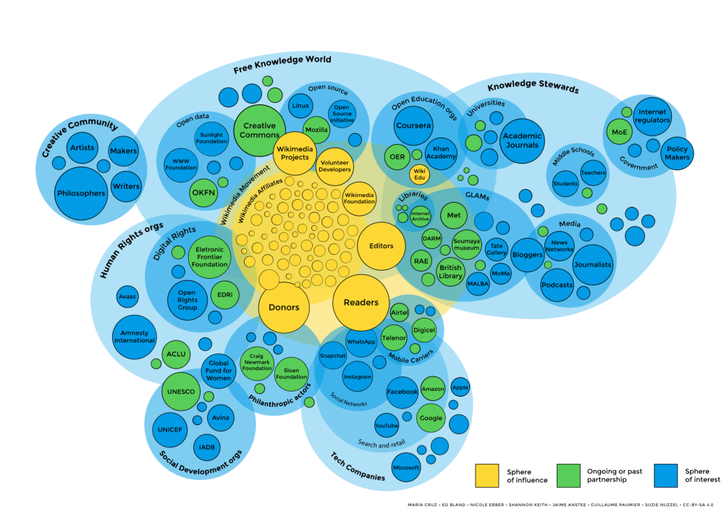
z
Part of wider open knowledge ecosystem
Maria Cruz, Ed Bland, Nicole Erber, Jaime Anstee, Guillame Paumier, Suzi Nuzzel – CC BY-SA

Slide 6
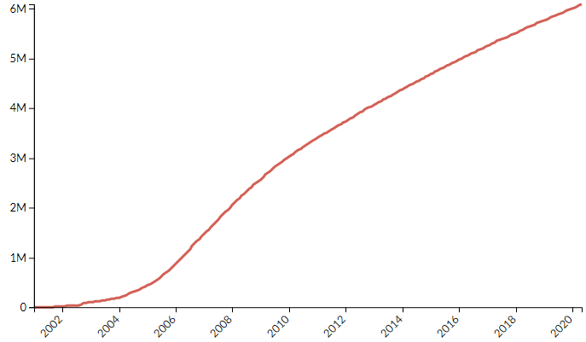
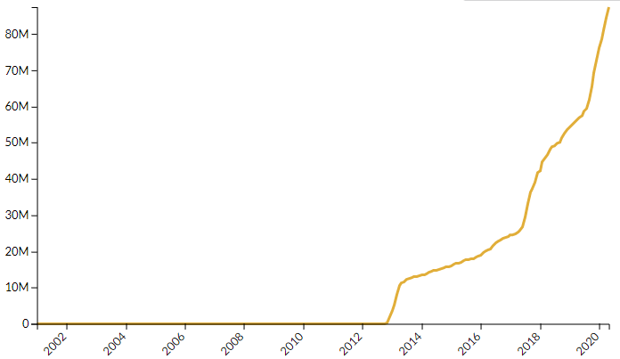
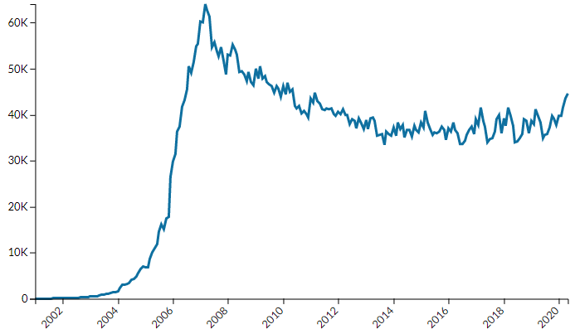
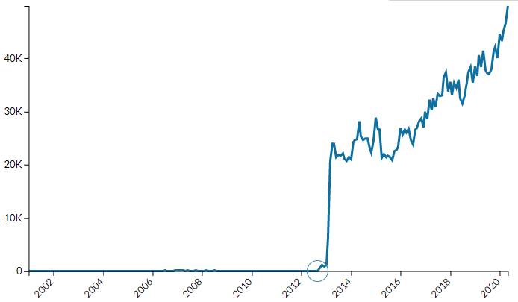
Wikipedia (en)
6M
Wikidata
80M
Number of articles
Number of items
60K
40K
Number of editors
Number of editors
https://stats.wikimedia.org
Notes:
General history in 4 graphs

Slide 7
Example items and properties
Concepts
E.g. locations, events, diseases, genes, languages, processes
Research outputs
E.g. publications, journals, publishers, clinical trials
People & orgs
E.g. Researchers, authors, universities, institutes
…
…
…
etc
COVID-19
(Q84263196)
Main subject (P921)
We Need Compassionate Leadership Management Based on Evidence to Defeat COVID-19
(Q96947691)
Author (P50)
Agnes Binagwaho
(Q4693015)
Has effect
(P1542)
cytokine release syndrome
(Q3961647)
Main subject (P921)
Colchicine
(Q326224)
Colchicine Coronavirus SARS-CoV2 Trial
(Q89154576)
Montreal Heart Institute
(Q3151984)
Research intervention (P4844)
Sponsor (P859)

Slide 8
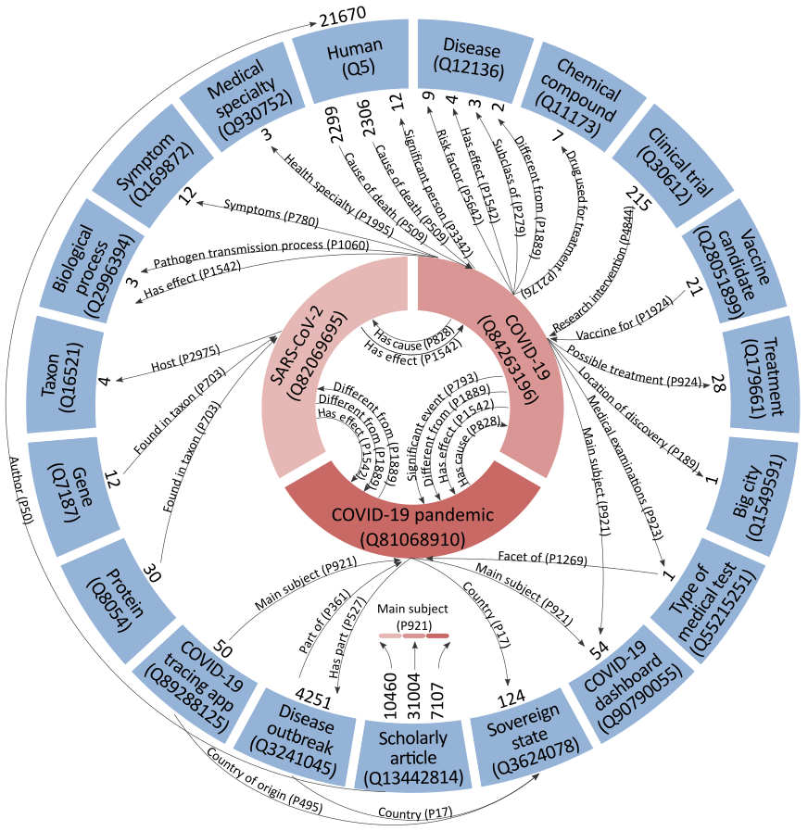
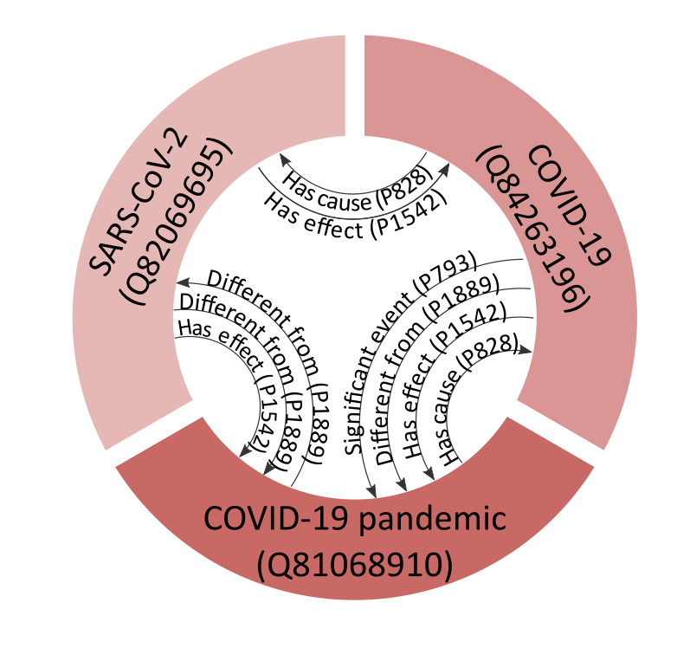
Thomas Shafee CC BY 4.0
Example items
and properties
Granular disambiguation of concepts
All of Wikidata tied into a single network
90M items
>1.1B connections
Links data from wide variety of disciplines

Slide 9
Outline
Why should you be interested in Wikidata?
A brief introduction to the largest open knowledgebase
Why you might draw data from it
Why you might deposit data into it
How to put data in
How read data from
Different ways to editing and create items
One at a time (direct manual editing)
Multiple at once (tool assisted batch editing)
Query information back out of Wikidata
SPARQL tool (and language)
A wide range of custom examples
Help, community and resources
The hidden world behind Wikidata

Slide 10
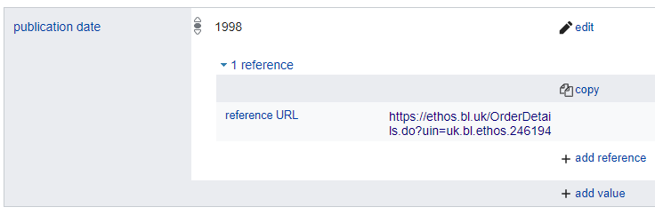

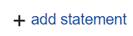
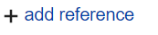
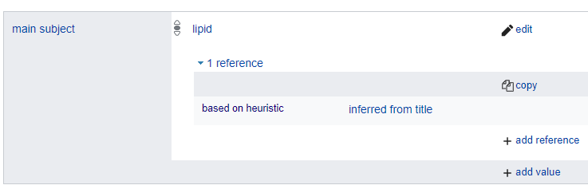
Lets manually edit an item
PhD theses that don’t list a publication date
Go to https://w.wiki/ekc and press
Find the thesis’s URL for the thesis
At the bottom of the Wikidata page,
Add “publication date” based on what’s listed at that URL
In that statement,
As the “reference URL”, use the thesis’s URL
PhD theses that don’t list a main topic
Go to https://w.wiki/ekg and press
Find the thesis’s URL for the thesis
At the bottom of the Wikidata page,
Add the main subject(s) based on the keywords or title
In that statement,
As the “reference URL”, add the thesis’s URL
(or) As the reference, add “based on heuristic” “inferred from title”

Slide 11
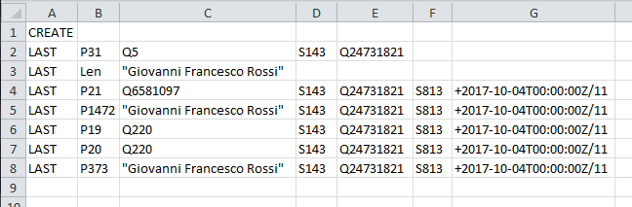
Lets bulk edit several items at once!
Two main tools: QuickStatements (https://quickstatements.toolforge.org)
OpenRefine (http://openrefine.org)
Import tabular data into Wikidata
Example:
Create a new item
It’s an instance of a human
Its label in English is…
Its sex/gender is male
Its place of birth is Rome
Its place of death is Rome
Item to edit
Statements to add
Supporting reference

Slide 12
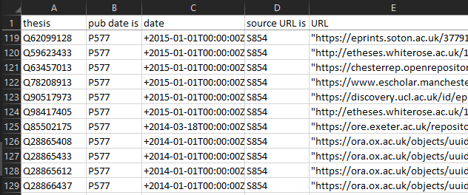
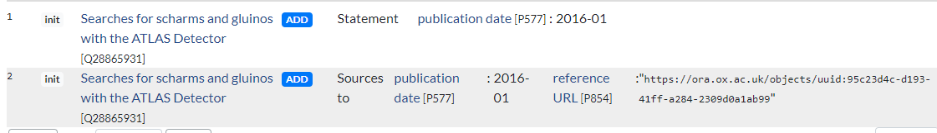
Lets bulk edit several items at once!
PhD theses that don’t list a publication date
Go to Docs for the list https://tinyurl.com/QStable
To see where this list came from, see https://w.wiki/f25
Go to https://quickstatements.toolforge.org
Paste across a few random rows from the table
“Import V1 commands” (if tab separated)
(or) “Import CSV commands” (if comma separated)
Hit “Run” to add the information to Wikidata
quickstatements.toolforge.org

Slide 13
Outline
Why should you be interested in Wikidata?
A brief introduction to the largest open knowledgebase
Why you might draw data from it
Why you might deposit data into it
How to put data in
How read data from
Different ways to editing and create items
One at a time (direct manual editing)
Multiple at once (tool assisted batch editing)
Query information back out of Wikidata
SPARQL tool (and language)
A wide range of custom examples
Help, community and resources
The hidden world behind Wikidata

Slide 14
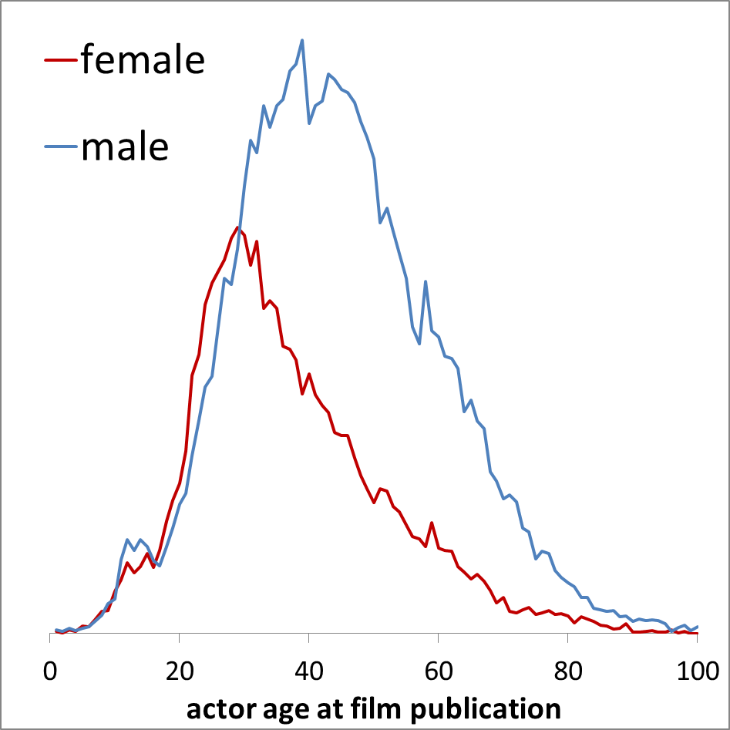
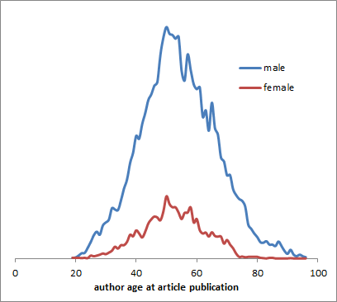
Example query results
Scholarly structured data
Research output metadata
Researcher identifiers
Knowledgebase querying
Gendered age bias: actors vs academics
Actors
Academics
Adapted from Toby Hudson, Uni. Sydney, CC- BY 4.0 ; https://w.wiki/Dw8 ; https://w.wiki/Dw9

Slide 15
More sophisticated tools
API
For WD
For QS
Python package
R package (in dev)

Slide 16
More complex use examples
Tunisian COVID-19 dashboard
https://speed.ieee.tn/
Where were witches in Scotland
https://witches.is.ed.ac.uk/
View all events on single timeline
http://histropedia.com/timeline/
Chlamidia genome browser
https://chlambase.org/
https://www.wikidata.org/wiki/Wikidata:Tools/Visualize_data

Slide 17
Outline
Why should you be interested in Wikidata?
A brief introduction to the largest open knowledgebase
Why you might draw data from it
Why you might deposit data into it
How to put data in
How read data from
Different ways to editing and create items
One at a time (direct manual editing)
Multiple at once (tool assisted batch editing)
Query information back out of Wikidata
SPARQL tool (and language)
A wide range of custom examples
Help, community and resources
The hidden world behind Wikidata

Slide 18
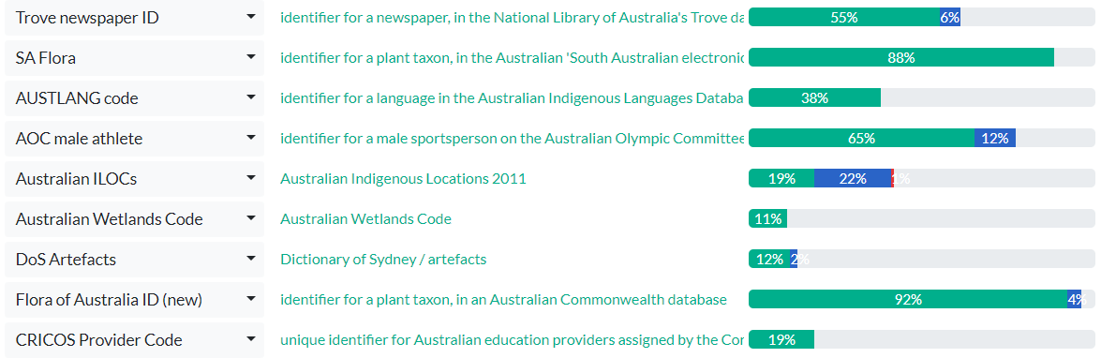
Wikidata research metadata
Author metadata
View example for Marilyn Anderson:
wikidata.org/wiki/Q44754645
wmflabs.org/scholia/author/Q44754645
>60M items
Authority control
Meta-cataloguing (e.g. mixnmatch)
mix-n-match.toolforge.org
Open citation network and annotation
tools.wmflabs.org/scholia/author
Publication metadata
Cited by | main topic | uses method | funded by | peer reviewer | handling editor | time from submission to publication | mentioned in news report/documentary

Slide 19
Conclusions
z
Ubiquitous student usage
Engagement opportunities for LTU
Librarians
Academics
Students
Highly linked to open ecosystem

Slide 20
Conclusions
z
Maria Cruz, Ed Bland, Nicole Erber, Jaime Anstee, Guillame Paumier, Suzi Nuzzel – CC BY-SA

Slide 22



Wikipedia info literacy
Abstinence-only education is ineffective
Read Wikipedia in last year for study or work:
Check warning notices (header, sections & talkpage)
Check the references
Check the internal quality rating (talkpage)
Therefore need to teach safe scholarship
Pseudo
peer-reviewed
Fox S, Jones S. Pew Internet. 2009 | Hughes B, Joshi I, Lemonde H, Wareham J. Int J Med Inform 2009 Oct;78(10):645-655 | Allahwala UK, Nadkarni A, Sebaratnam DF. Med Teach 2013 Apr;35(4):337 | Nutzung von Social-Media-Diensten in der Wissenschaft 2017 Goportis – Leibniz-Bibliotheksverbund
Notes:
Also 87% of teachers
Also 35% of pharmacists
Policymakers and Journalists
Lawmakers have cited Wikipedia in >400 judicial decisions

Slide 23
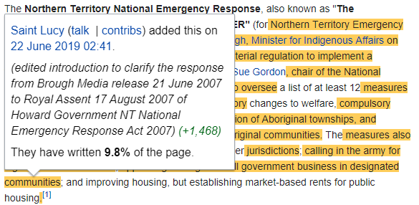
Wikipedia info literacy
Abstinence-only education is ineffective
Read Wikipedia in last year for study or work:
Check warning notices (header, sections & talkpage)
Check the references
Check the internal quality rating (talkpage)
Therefore need to teach safe scholarship
Advanced:
Only cite WP directly if describing/studying what is stated therein
“Wikipedia presents a lay definition of X as… (page, date, version link)”
History and whocolor tool show when and who added content
Fox S, Jones S. Pew Internet. 2009 | Hughes B, Joshi I, Lemonde H, Wareham J. Int J Med Inform 2009 Oct;78(10):645-655 | Allahwala UK, Nadkarni A, Sebaratnam DF. Med Teach 2013 Apr;35(4):337 | Nutzung von Social-Media-Diensten in der Wissenschaft 2017 Goportis – Leibniz-Bibliotheksverbund
Notes:
Also 87% of teachers
Also 35% of pharmacists
Policymakers and Journalists
Lawmakers have cited Wikipedia in >400 judicial decisions

Slide 24

Wikipedia student writing
Examples
Currently primarily US, Canada (some Europe)
Pharmacology | Boston University
Chemistry | Massachusetts Institute of Technology
Interdisciplinary social science | Rice University
Literature | Georgetown University
Students work in group to write/update a Wikipedia page
Supervision by course organiser
Support by WikiEdu foundation
Free online LMS system
dashboard.wikiedu.org
Free training materials
Best practice documentation
Efficacy
Increased student information literacy
High satisfaction outcomes
Cheap to run
High exposure of student work
Azzam, Amin, et al. "Why medical schools should embrace Wikipedia: final-year medical student contributions to Wikipedia articles for academic credit at one school." Academic medicine 92.2 (2017): 194. doi.org/10.1097/ACM.0000000000001381

Slide 25


Wikipedia scholarly writing
Example journals
PLOS Genetics
PLOS CompBiol
Wiki.J.Med
Wiki.J.Sci
Wiki.J.Hum
Journal first
Open Medicine
Wiki.J.Med
Wiki.J.Sci
Wiki.J.Hum
Content published into both Wikipedia and academic corpus
Stable, citable, peer-reviewed version with the credibility of a scholarly journal
Living version with extreme impact of Wikipedia
Wikipedia first
RNA Biology
Gene
Wiki.J.Med
Wiki.J.Sci
Wiki.J.Hum
Contributions by LTU authors
Parallel
Read >1.7 million times per annum
Notes:
Note: LTU publishes ~2500 papers per annum, so expected readership ~2.5 mil per annum.

Slide 26
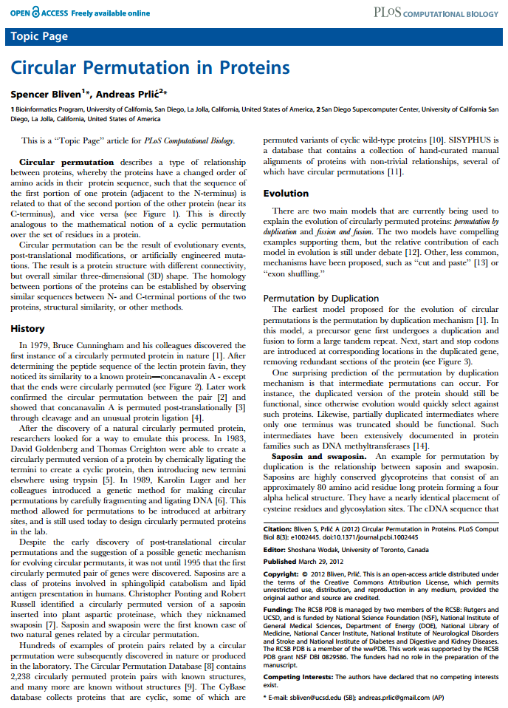
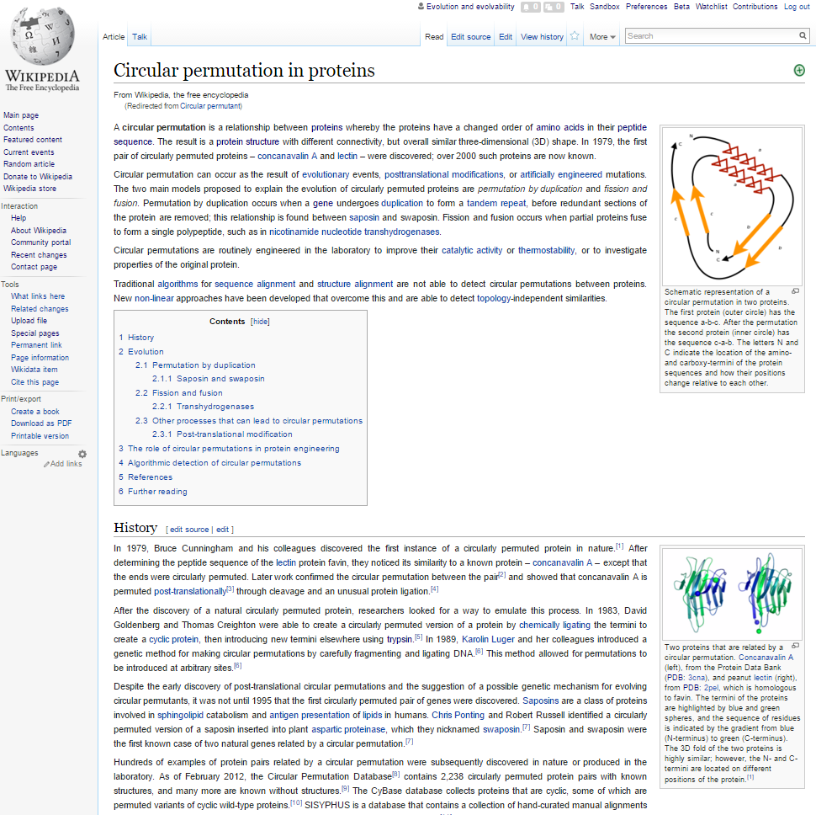
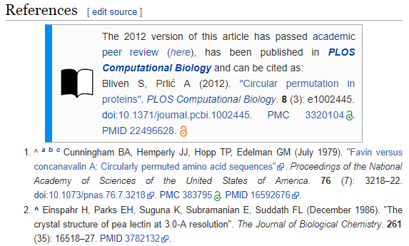
Academic and Wikipedic versions

Slide 27
Wikipedia biographies
Single-day event
Unimelb ‘researchHER’ event
1 day
14 new biographies
Discussed in SMH, 3CR, Pursuit
Few LTU scholars and alumni have biographies
► La Trobe University alumni‎ (98 P)
► Chancellors of La Trobe University‎ (6 P)
► La Trobe University faculty‎ (63 P)
Require third-party sources
Require notability (WP:PROF)
Avoid COI by training ppl how to edit (but not tell them what to write)
Extended event
Scientific committee on Antarctic Research
3 months
117 new biographies
Discussed in Nature, ABC, the Age, 3RRR
https://en.wikipedia.org/wiki/Category:La_Trobe_University

Slide 28
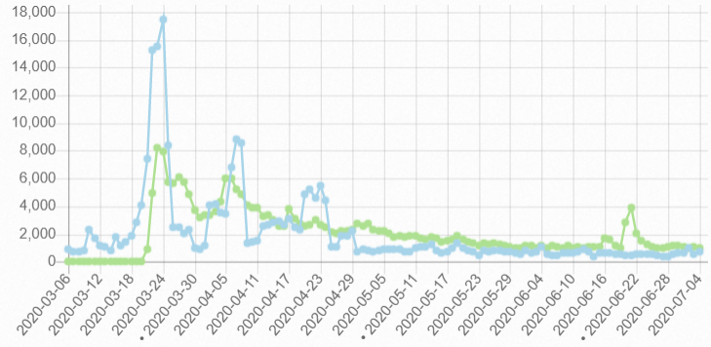
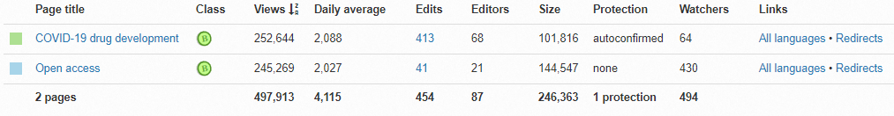
Wikipedia Impact assessment
Detailed pageview stats available
All readers read the lede section
Subsequent sections are each read by ~20%
Basic AltMetrics on research outputs
Pageviews analysis
Where: Which page(s) and which section(s) cites it?
What: Is it supporting important or trivial point? Is it cited multiple times?
When: How long has the citation been there?
https://pageviews.toolforge.org/

Slide 29

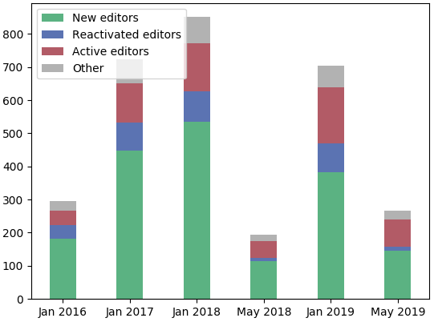
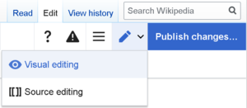
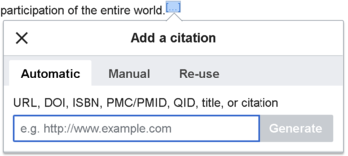
Wikipedia direct contribution
Detailed pageview stats available
Organised by the Wikipedia Library
#1lib1ref campaign
Citation hunt tool
tools.wmflabs.org/citationhunt
Number of librarians
Powered by Zotero
meta.wikimedia.org/wiki/The_Wikipedia_Library/1Lib1Ref

Slide 30

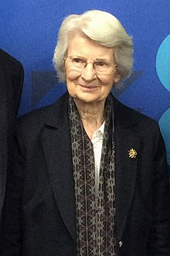


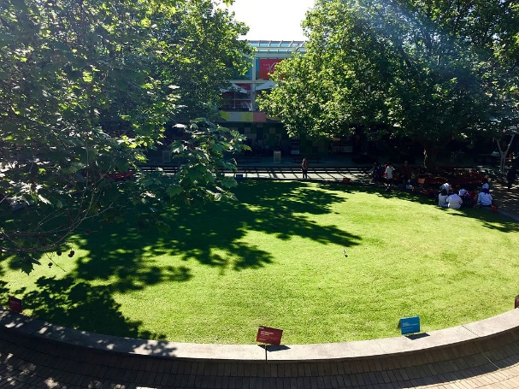
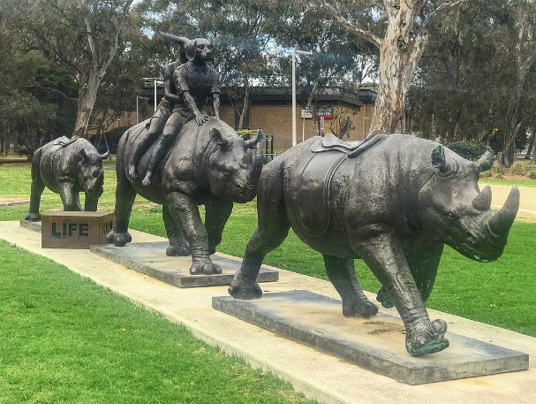
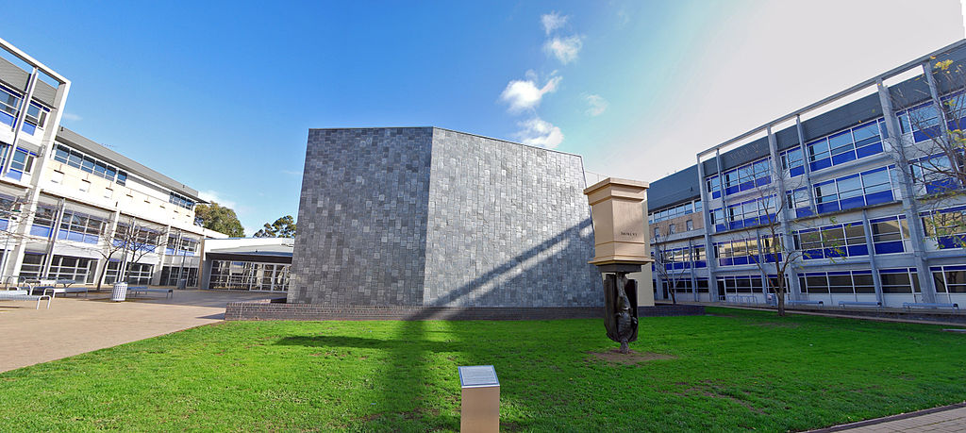
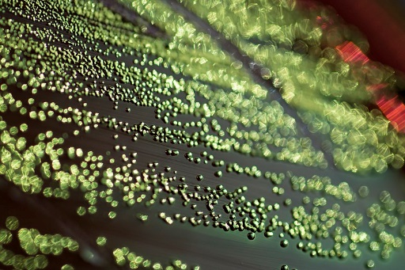
Wikicommons
z
Academic images & diagrams
Staff photos (current & alumni)
Archives and records
Image competitions
The only image of an LTU chancellor
Only 4 images of faculty
Student winner of image competition

Slide 31
Combining reach and rigour
compatible interfaces between two worlds

Slide 32
Who reads Wikipedia?
Thesis
1-10
Median Wikipedia page
10,000 pa
Median Journal Paper
800
Readership includes: Researchers
Students
Patients
Journalists
Clinicians
Lawmakers
Top 5% Journal Paper
3,000
Top 5% Wikipedia page
1,000,000 pa
Shafee T (2017) Wikipedia-integrated publishing: a comparison of successful models. Health Inform. 26(2)
Notes:
Re-emphisise that patients are making health decisions based on what they read online

Slide 33
Who reads Wikipedia?
Covid-19
400,000 per day
Thesis
1-10
Median Wikipedia page
10,000 pa
Median Journal Paper
800
Readership includes: Researchers
Students
Patients
Journalists
Clinicians
Lawmakers
Top 5% Journal Paper
3,000
Top 5% Wikipedia page
1,000,000 pa

Slide 34
Quality control
Creation
Articles for Creation (Drafts not yet added to encyclopedia)
New page patrol (Articles recently added)
>2000 new articles submitted per day (70-80% are deleted)
Modification
Articles for Deletion
Speedy deletion (1 day)
Proposed deletion (1-4 weeks)
50 per day
Deletion
Notes:
Overall Birth-and-Death model for articles, but most work done in modification
>300 active editors in each stage
600 new articles per day
500 deletions per day

Slide 35
Quality control
Bots
(<1 minute)
Human
(<1 hour)
Human
(hours - days)
Quality rating
Machine-learning:
Watching new edits stream
Apprx. 100 at any time
e.g. sentences lacking references
Checking for more subtle errors
Bayesian neural network
Turnitin: Copyright violation
Creation
Modification
Deletion
Notes:
Overall Birth-and-Death model for articles, but most work done in modification

Slide 36


Quality control
Creation
Editorial review
5-10 reviewers
1 reviewer
Internal assessment
Modification
Wikipedia’s Plant Biology pages
Quality comparable to Encyclopædia Britannica back in 2005
Accuracy varies by topic, but broad trends:
Inconsistent coverage
Missing / out of date information
Missing illustration
Difficult readability
Deletion
External assessment
Nature 2005 438:900 | S Fox, M Duggan Pew internet 2013 | T Shafee et al. (2017) JECH. 71(10)
Notes:
Overall Birth-and-Death model for articles, but most work done in modification

Slide 37
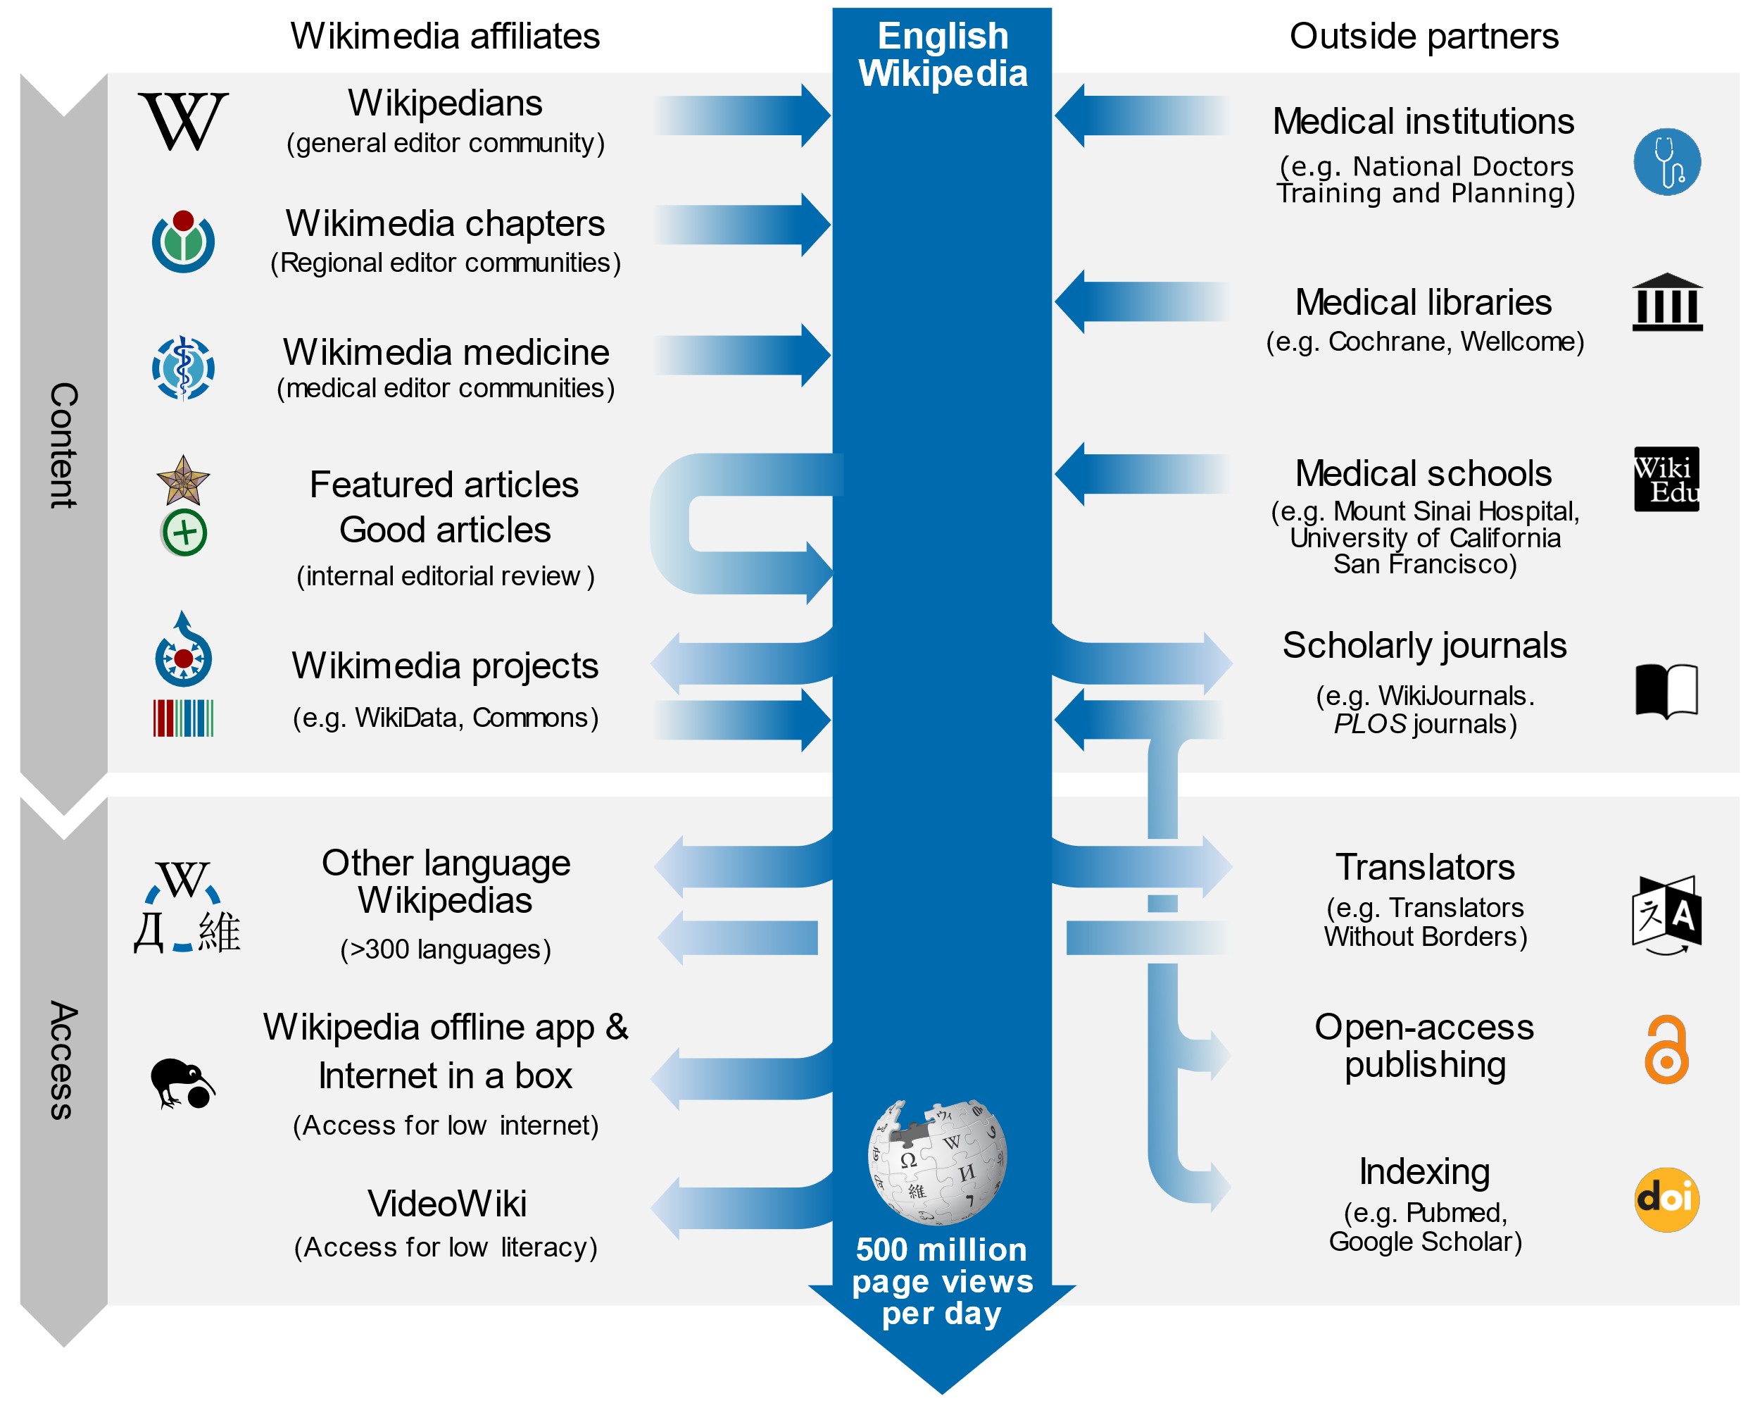
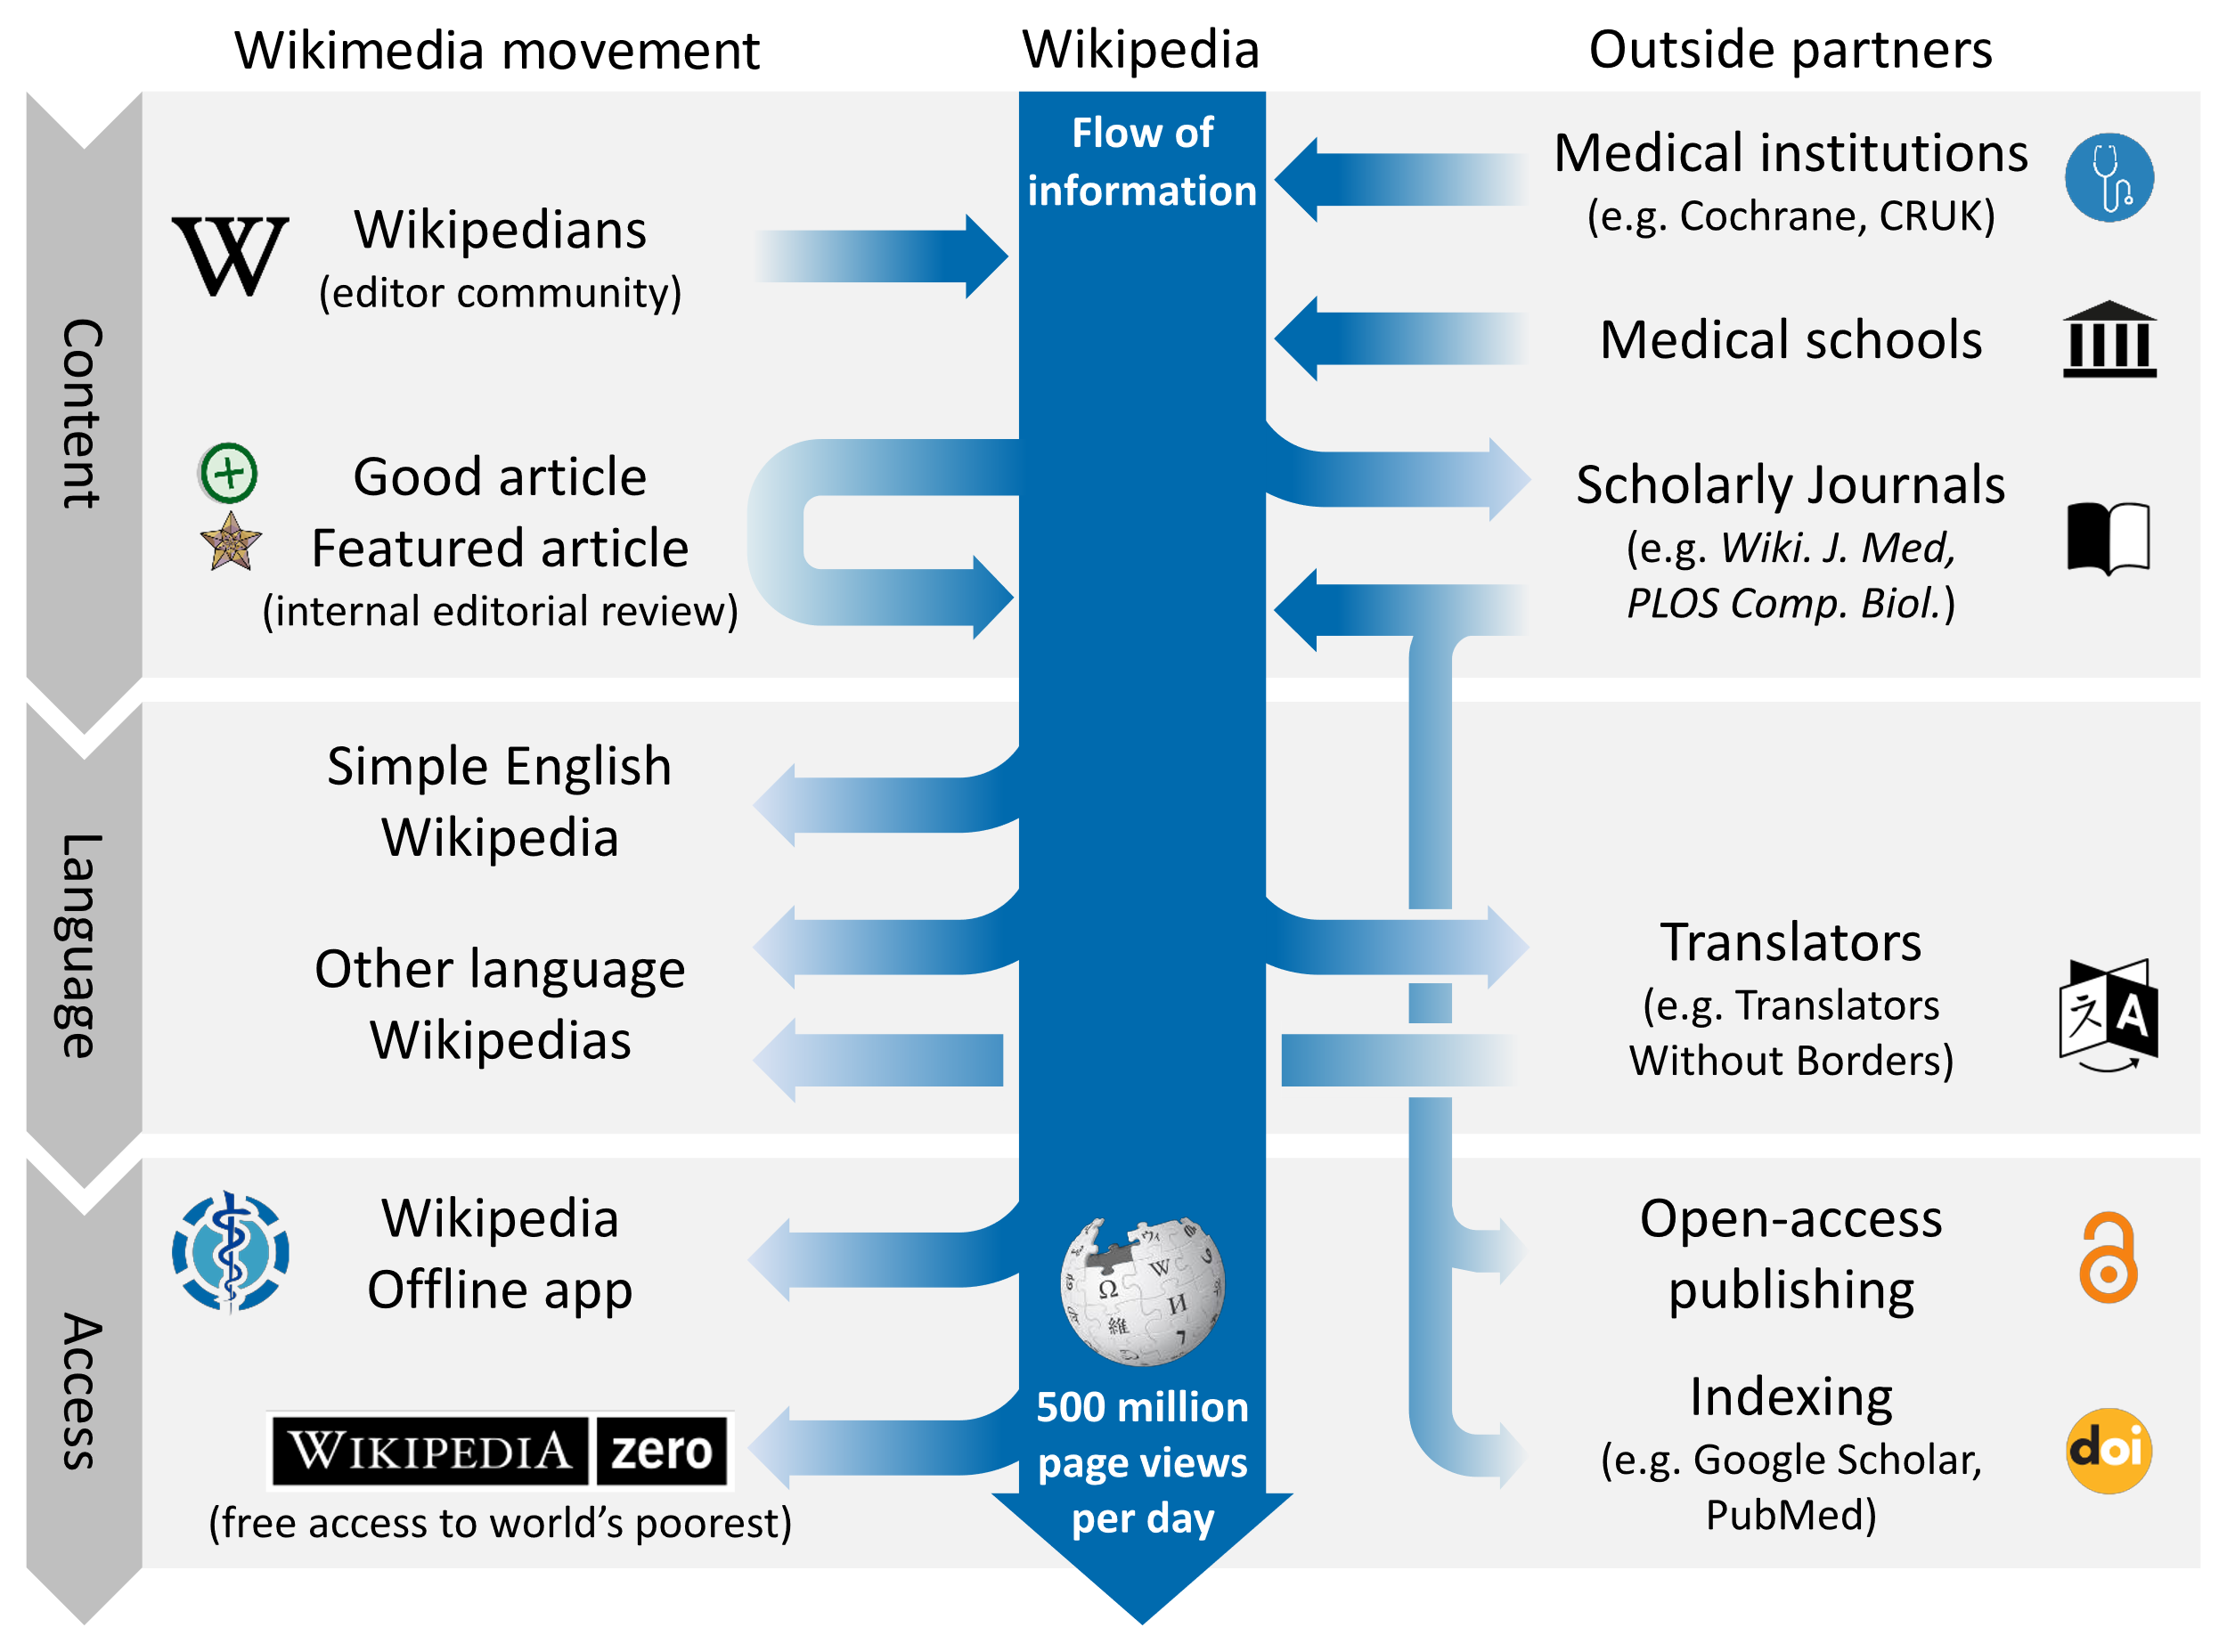
Interactions with the knowledge ecosystem

Slide 38
Implementation models
Practical and proven methods

Slide 39





Development of concepts
2008 – RNA Biology starts requiring authors to update Wikipedia
2014 – Open Med puts Wikipedia page through peer review
2014 – WikiJMed publishes first issue
2018 – WikiJSci & WikiJHum publishes first issue
2012 – PLOS Comp Biol starts publishing ‘topic page’ review format
2013 – Gene starts Gene Wiki Reviews
2018 – PLOS Genetics also starts publishing ‘topic page’ format

Slide 40


Bridging the academic divide
Compatible with any OA journal
Simplest workflow
Well-suited to topics that are missing/start/stub on Wikipedia
Content published into both Wikipedia and academic corpus
Stable, citable, peer-reviewed journal version
Living version with extreme impact of Wikipedia
Example journals
PLOS Genetics
PLOS CompBiol
PLOS ONE
Wiki.J.Med
Wiki.J.Sci
Wiki.J.Hum
Open Medicine
Gene
RNA Biology
Journal first
Restricted by Wikipedia’s CC-BY-SA license
May be only option for highly-developed pages (full replacement typically more difficult Class B and above)
Wikipedia first
Compatible with closed journal
Two versions can be tailored to different audiences
Increased work for authors and reviewers
Parallel
Shafee, T. (2017). Wikipedia-integrated publishing: a comparison of successful models. Health Inform., 26(2).

Slide 41
Academic and Wikipedic versions

Slide 42
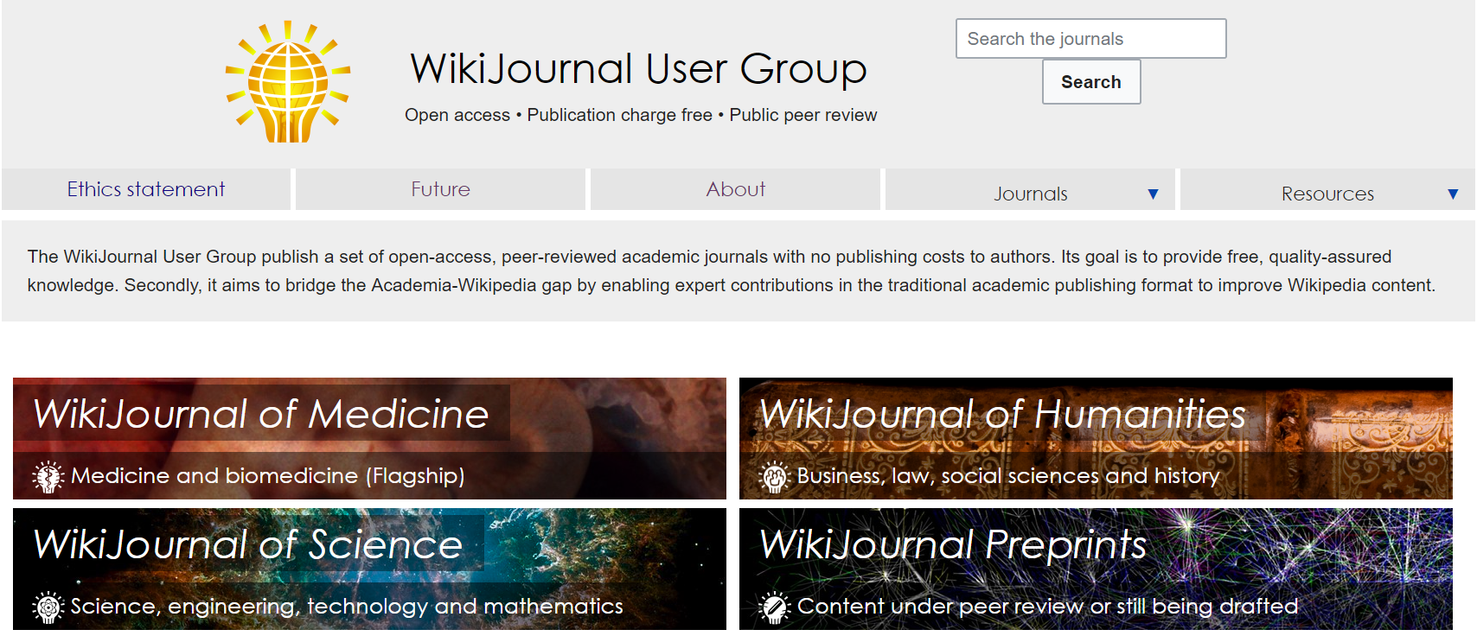
WikiJournals

Slide 43
Example case studies in WikiJournals
Update using Wikipedia page contents as starting point
In all quality ratings cases, individual article sections can typically be rewritten from scratch
Update by re-writing from scratch

Slide 44
Example case studies in WikiJournals
Full review articles
Article sections
Stand-alones
Existing high-quality Wikipedia article updated and submitted
Peripatric speciation
Rosetta stone
Wikipedia article previously existing but flawed/outdated
Lysine
Wikipedia article previously completely absent/stub
Anthracyclines
Wikipedia article section that warranted own page
Gene structure
Wikipedia article previously lacked images
Cell disassembly during apoptosis
Case study
Acute gastrointestinal bleeding from a chronic cause: a teaching case report
Teaching method
A card game for Bell's theorem and its loopholes
Systematic review
Mealtime difficulty in older people with dementia
Image gallery
Medical gallery of Blausen Medical
Partner articles
More technical partner
Dioxins and dioxin-like compounds

Slide 45
A WikiJournal’s publishing flow
Publication
PDF
Citable
Stable
Indexed
Version of record
Preprint
server
Public
peer review
HTML
doi
Highly accessed
Broad readership
Editable and updatable
Wikipedia-integration
WikiJSci Editorial Board. (2018). The aims and scope of WikiJournal of Science. WikiJSci 1(1)

Slide 46
A WikiJournal’s publishing flow
Preprint server
Publication
PDF
Citable
Stable
Indexed
Version of record
Public
peer review
HTML
doi
Highly accessed
Broad readership
Editable and updatable
Wikipedia as preprint
Wikipedia-integration
WikiJSci Editorial Board. (2018). The aims and scope of WikiJournal of Science. WikiJSci 1(1)

Slide 47
A WikiJournal’s publishing flow
Preprint server
Publication
PDF
Citable
Stable
Indexed
Version of record
Public
peer review
HTML
doi
Highly accessed
Broad readership
Editable and updatable
Versioning
Wikipedia as preprint
Wikipedia-integration
WikiJSci Editorial Board. (2018). The aims and scope of WikiJournal of Science. WikiJSci 1(1)

Slide 48
Sooooo… who pays?
Reader subscription / author (e.g. Gene, RNA Biol)
Typically charge subscription fees
Article processing fee of $3300 and $2000 respectively
Journal fee waiver (e.g. PLOS)
For Topic Page review articles, PLOS waives its usual $2250 processing fee
Charitable foundation (e.g. Wiki.J.Med.)
Web hosting cost is covered by the Wikimedia Foundation
Editors donate volunteer labour so no fees of any kind

Slide 49
What does the future hold?
Maximising potential value

Slide 50
Wikimedia journal hosting platform
Wikipedia Sister project
In whole
WikiJournals
PLOS Genetics
Host
Format
Example
One-off
examples in negotiation
In part
Features
Free interface for formatting articles ready for Wikipedia
Expert editors who give free advice and assistance
Specialist tools for facilitating the process

Slide 51
Wikimedia journal hosting platform
Site identity and branding
journals.wikimedia.org / wikijournals.org / journals.wiki / j.wiki
Specialised sidebar items and logos
CC BY default license
Automation of repetitive tasks
Assigning DOIs
Copying accepted articles into latest volume & issue
Formatting PDFs
Specialised extensions
Annotating history to mark version as published
Automated email reminders to reviewers
Wikidata integration to track peer reviews submitted to talkpages
Features

Slide 52

Contact
Email Thomas.Shafee@gmail.com
Google Scholar Thomas Shafee
ResearchGate Thomas Shafee
LinkedIn Thomas Shafee
Journals
WikiJournal of Medicine (WikiJMed.org)
WikiJournal of Science (WikiJSci.org)
PLOS (TopicPagesWiki.plos.org)
Wikipedia
My userpage Search “User:tshafee”
WikiProject Medicine Search “WP:MED”
This presentation
bit.ly/WikiJournal2020b
Shafee, T; Mietchen, D; Su, A. (2017). “Academics can help shape Wikipedia”. Science. 357 (6351): 557–558.
Shafee, T; Masukume, G; Kipersztok, L; Das, D; Häggström, M; Heilman, J. (2017). “The evolution of Wikipedia’s medical content: past, present and future”. JECH. 71(10).
Shafee, T (2017) “Wikipedia-integrated publishing: A comparison of successful models”. Health Inform. 27(2)
WikiJSci Editorial Board (2018). “The aims and scope of WikiJournal of Science”. WikiJournal of Science 1(1):1

Slide 53
[end]

Slide 54
Possible journal partnership system
One-off partnering with subject-specialist journals
Specialist journal: Invite authors, identify peer reviewers
WikiJournal: Advises on wikipedia policy compliance, readability and formatting
Resulting article co-published in specialist journal & WikiJournal
Then copied into Wikipedia per ‘journal-first’ model
Co-publishing example:
Staniszewska, S., et al. (2017). GRIPP2 reporting checklists: tools to improve reporting of patient and public involvement in research. Research involvement and engagement, 3(1), 13.
Staniszewska, S., et al. (2017). GRIPP2 reporting checklists: tools to improve reporting of patient and public involvement in research. British Medical Journal 358(1), j3453

Slide 55
Committee on Publication Ethics
WikiJMed ethics statement audited and approved by COPE
WikiJMed.org/Ethics_statement
Attribution of CC material
Images / videos / other media: Attribution and license type at end of the figure legend
Text <1 paragraph / <10% of final work: Hyperlink to contributor list 'Acknowledgements' section
Text >1 paragraph / >10% of final work: Hyperlink to the full contributor list included in the author list (typically as a hyperlinked "et al"). Treated as “Large group authorship”.
Ownership
Journal article released by authors under creative commons license of their choice
Material integrated into Wikipedia may be edited by anyone (inc. authors) and will evolve over time
What constitutes a preprint
Wikipedia can be treated as a preprint server where the submitting author has been a significant contributor
Dual publication into Wikipedia
Material that complies with Wikipedia’s guidelines (e.g reviews / images) can be directly integrated via CC license
Materia that does not (e.g. original research / opinion / speculation) can be cited as a source in a Wikipedia article

Slide 56
Contributions
Submit an article. Credentials are not necessary.
Peer reviewing of article submissions. Does require expertise in the subject at hand.
Help preparing & formatting submitted articles
Join an editorial board and share your ideas about journal management
Will hire a technical editor.

Slide 57
Similarities and differences
 | Academic Journal | Wikipedia
Readership size | Small and brief Median article - 800 total Top 5% article - 3000 total | Very large and extended Median article - 10,000 per year Top 5% article - 1,000,000 per year
Readership composition | Other academics, often within narrow field | General public as well as experts and professionals
Peer review | Pre-publication, private review by 2-4 subject specialists | Post-publication public review of a sort by subject generalists ‘Good article’ - 1 reviewer ‘Featured Article’ - 5-12 reviewers
Reputation | Varies by journal but generally extremely high | Public generally trust Academics have mixed opinions but improving
Authorship | Small number with relevant, accredited expertise. Organised group with lead and corresponding authors. | Large number with mixed expertise levels. Loose organisation. Many pseudonymous or anonymous.
Timeliness | Static Updated by new publications | Constantly updated Only one consensus version
Shafee, T. et al. (2017). Evolution of Wikipedia’s medical content: past, present and future. JECH. 71(10)

Slide 58

The future of data
Free, open, structured knowledge base
Humans and machine readable and editable
Multilingual, queryable
Standardised, centralised, highly interlinked
Statements, sources, and connections to other databases
Item | Property | Value
Q42 | P69 | Q691283
Douglas Adams | educated at | St John's College

Slide 59


